Slide 1
Using Declarative Jenkins Pipelines
INTRODUCING PIPELINES AND THE JENKINSFILE

Slide 2


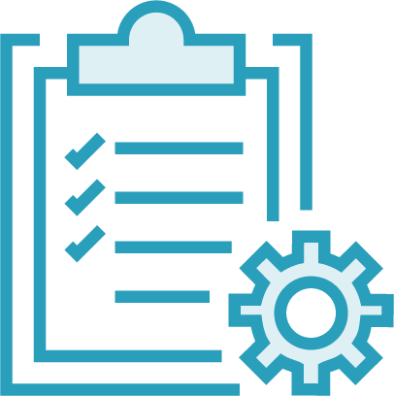
Repo URL Credentials
Source Code
Poll SCM CRON
Triggers
Build Environment
Secrets Certificates
Build Test
Build
Post- build
Publish/deploy Notify
config.xml

Slide 3








config.xml
Auth
Auth
Single truth
Diffs
Versioning

Slide 4

Jenkinsfile

Slide 5
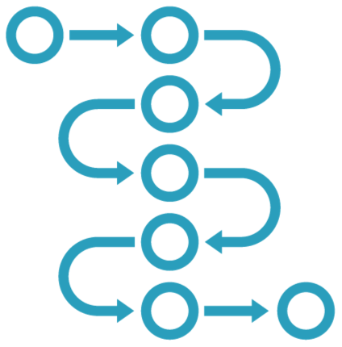
Repo URL Credentials
Source Code
Poll SCM CRON
Triggers
Build Environment
Secrets Certificates
Build Test
Build
Post- build
Publish/deploy Notify
Jenkinsfile

Slide 6
Jenkinsfile
pipeline {
agent any stages {
stage('Build') { steps {
sh 'docker-compose build'
}
}
stage('Test') { steps {
sh 'docker run pi -dp 7'
junit 'test-results/results.xml'
}
}
...
Declarative syntax
Structured format
Core features
Agent tools
Plugin integration

Slide 7

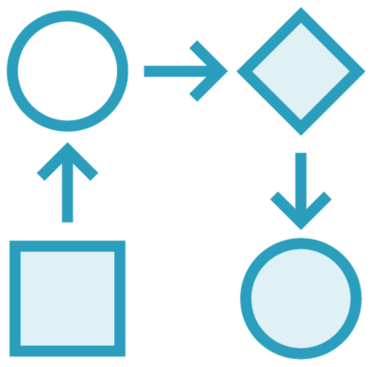
Introducing Pipelines and the Jenkinsfile
Building Re-usable Pipelines
Using Pipelines to Support Your Workflow

Slide 8

Demo
Creating and running simple pipelines
Using the classic UI
From Jenkinsfile in source control

Slide 9
Agent
Pipeline
Environment variables
Name Agent
Environment variables
Stage
Classic UI
Step
echo Print message
Source control
sh Run script

Slide 10
◀ Top-level declaration
pipeline {
agent any environment {
DEMO='1.3'
}
stages {
stage('stage-1') { steps {
echo "Demo $DEMO"
sh '''
echo "Multi-line shell step" chmod +x test.sh
./test.sh '''
}
...
◀ Run on any node
◀ Value available to all steps
◀ Named stage
◀ Steps can access variables
◀ Beware escapes and string interpolation
◀ Workspace clones source repository

Slide 11

Single quotes - literal
Double quotes - interpolated
echo 'This is a $VARIABLE'
This is a $VARIABLE
echo "This is a $VARIABLE"
This is a demo
echo "This is a ${VARIABLE}"

Slide 12
Single quotes - literal
Double quotes - interpolated
'''
echo "This is a $VARIABLE" echo "This is a ${VARIABLE}"
'''
sh
This is a demo
"""
sh
"""
echo | 'This | is | a | $VARIABLE'
echo | 'This | is | a | ${VARIABLE}'
echo | 'This | is | a | ${env.VARIABLE}'

Slide 13
Demo
Modelling workflows in pipelines
Stages and steps
User input and post-build
Parallel stages

Slide 14

Agent
Environment variables
Pipeline
Name
Environment variables
Stage
Name
Environment variables
Stage
Step
echo
Print message

Slide 15
Agent
Environment variables
Pipeline
Name
Environment variables
Stage
OK message Parameters
Input
Post
Condition

Slide 16
Agent
Environment variables
Pipeline
Parallel
Name
Environment variables
Stage
Name
Environment variables
Stage
Post
Condition

Slide 17
Jenkinsfile
pipeline {
stages {
stage('Build') {
parallel { ... }
}
stage('Deploy') {
input { ... }
}
}
post {
always { ... }
}
}
Parallel stages
User confirmation
Cleanup
No actual build…

Slide 18

Agent
Environment variables
Pipeline
Name Agent
Environment variables
Stage
Step
echo
sh
retry
junit
s3Upload
unzip
kubernetesDeploy

Slide 19
Demo
Adding pipeline build functionality
Core pipeline steps
Plugin pipeline steps
Scripted Groovy steps

Slide 20

echo
Step
sh
writeFile
archiveArtifacts
workflow-basic-steps
workflow-aggregator
withCredentials
credentials-binding
script
pipeline-model-definition

Slide 21
writeFile file: 'test-results.txt', text: 'passed'
◀ Writes plain text to a workspace file
archiveArtifacts 'test-results.txt'
◀ Archives workspace file(s)
withCredentials([string( credentialsId: 'an-api-key', variable: 'API_KEY')])
◀ Makes secrets available to steps

Slide 22
◀ Groovy code
script {
if (Math.random() > 0.5) { throw new Exception()
◀ Requires script approval
}
}

Slide 23

Declarative pipelines
Alternative to freestyle jobs
Jenkinsfile lives in source control
Standard Jenkins plus plugin
Structured model
Pipelines, stages and steps
Parallel execution and user input
Not a build system
Extensible
Standard plugin mechanism
Dual-purpose plugins
Summary

